Slide 1


Heart Disease Prediction: An Exploratory Data Analysis
An overview of our exploratory data analysis project, focusing on heart disease prediction using a unique dataset.
Contributors:
Janani Srinivasan
Monisha B R
Praveenkumar
Varsha
Viswanath Viralam Ramamurthy

Slide 2

Project Overview and Objectives
Heart Disease Prediction
Importance of EDA
The primary goal of this project is to predict heart disease using Exploratory Data Analysis. Our analysis focuses on a comprehensive dataset that includes traditional medical indicators and a novel QuantumPatternFeature.
Exploratory Data Analysis is crucial for understanding the dataset, identifying patterns, and assessing data quality. It lays the foundation for building effective predictive models.
Specific Objectives
Our objectives include identifying key factors contributing to heart disease, uncovering hidden patterns, and ensuring the dataset's quality and reliability for subsequent modeling.
This project aims to leverage these insights to develop robust models that can assist in early detection and prevention of heart disease.

Slide 3
Data Set Description: Understanding the Data
Heart Disease Dataset
Quantum Pattern Feature
Data Source
This dataset is specifically designed for heart disease prediction. It integrates traditional medical indicators such as age, gender, blood pressure, and cholesterol levels.
The dataset includes a unique "QuantumPatternFeature," adding a novel dimension to the analysis. This feature aims to capture complex patterns not typically identified by traditional medical indicators.
The dataset is sourced from a combination of clinical studies and synthesized data to ensure a comprehensive representation of various health factors. The integration of real and artificial data aims to enhance the robustness and generalizability of our analysis.

Slide 4

Key Clinical Features
Age
Numerical data representing the patient's age. Expected to have a positive correlation with heart disease risk.
Gender
Categorical data indicating the patient's gender. Gender differences may influence heart disease prevalence and risk factors.
Blood Pressure
Numerical data representing the patient's blood pressure levels. High blood pressure is a known risk factor for heart disease.
Cholesterol
Numerical data representing the patient's cholesterol levels. Elevated cholesterol is a significant contributor to heart disease.
These features, along with the quantum pattern, provide a holistic view for predictive analysis.

Slide 5






Visualizing Key Points
Data Shape
Summary Statistics
Missing Values
Null Value Check
Dataset: 506 rows, 7 columns
Calculated for numerical and categorical columns using Pandas.
8 missing values identified and handled by filling N/A.
Ensured no remaining null values in the dataset.
Duplicate Values
Python Libraries
5 duplicate values found and removed.
Pandas, Numpy, Matplotlib, Seaborn utilized

Slide 6

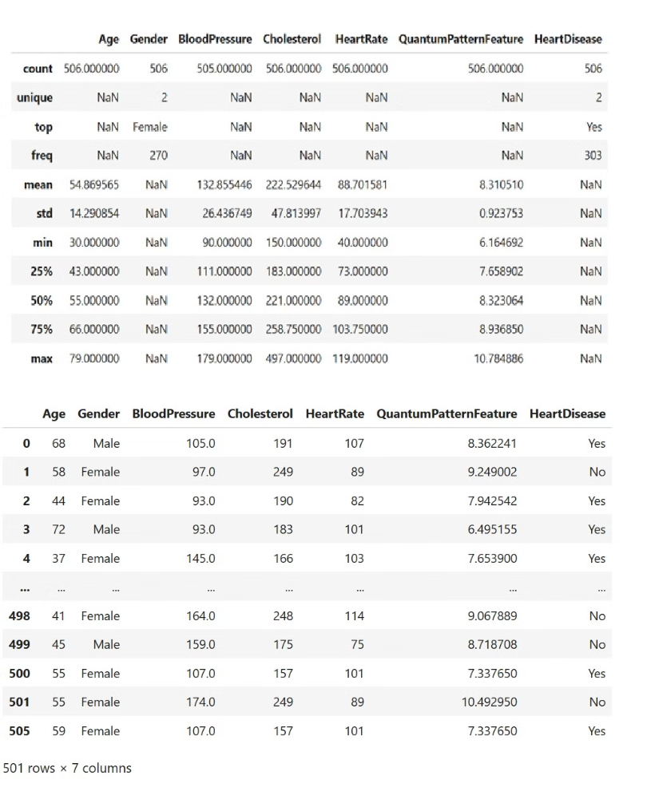


Data Cleaning and Preprocessing
Handling Missing Values
Imputation strategies were employed to fill in missing data, ensuring no loss of valuable information. Mean and median imputation techniques were used based on the distribution of the data.
Addressing Outliers
Outliers were identified using statistical methods such as the IQR (Interquartile Range). These outliers were then treated to prevent skewed results.

Slide 7

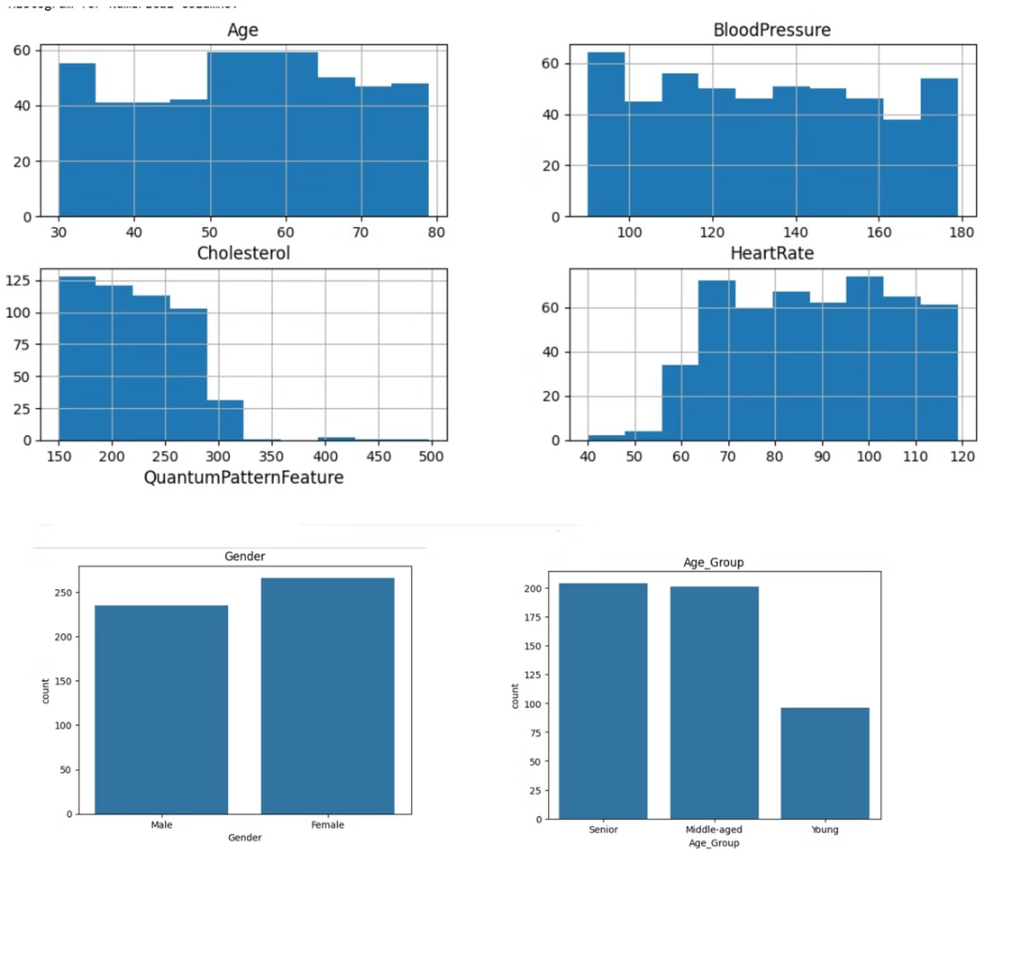
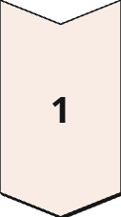
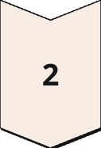
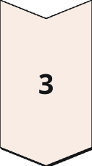
Univariate Analysis: Individual Feature Examination
Histograms for Numerical Features
Histograms were generated for Age, Blood Pressure, Cholesterol, Heart Rate, and QuantumPatternFeature. These visualizations provide insights into the distribution of each feature.
Bar Charts for Categorical Features
Bar charts were used to visualize the distribution of Gender, providing a clear view of the gender balance within the dataset.
Summary Statistics
Summary statistics (mean, median, standard deviation, etc.) were calculated for each feature. These statistics offer a quantitative overview of each variable.

Slide 8

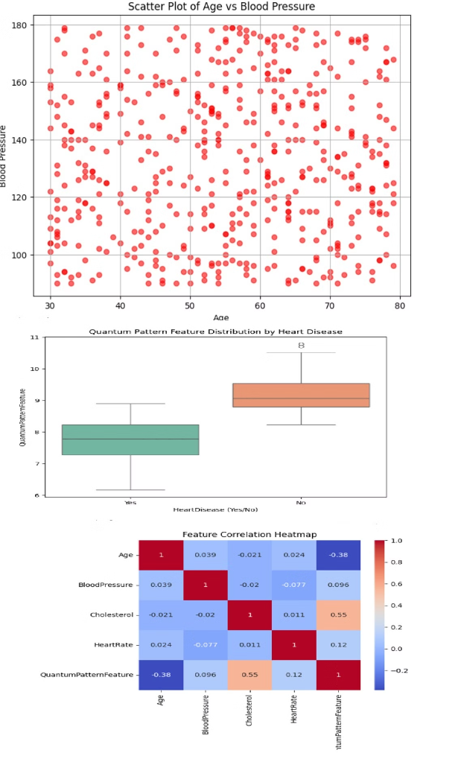
Bivariate Analysis: Feature Relationships
Scatter Plots
Showed relationships between age and Blood Pressure.
Box Plots
Individuals with heart disease (Yes) seem to have higher median values for the Quantum Pattern Feature
This suggests a possible link between higher Quantum Pattern values and heart disease presence.
However, there is some overlap, meaning this feature alone might not be a strong predictor but could contribute in combination with others.
Correlation Matrix
Age vs Blood Pressure - Blood pressure rises with age.
Cholesterol vs Age - Cholesterol increases with age, due to lifestyle and metabolism.
Close to +1,it means cholesterol levels increase with age, which is common due to lifestyle and metabolic changes.
Close to -1,it means heart rate decreases with age, which may indicate reduced cardiovascular efficiency over time.

Slide 9

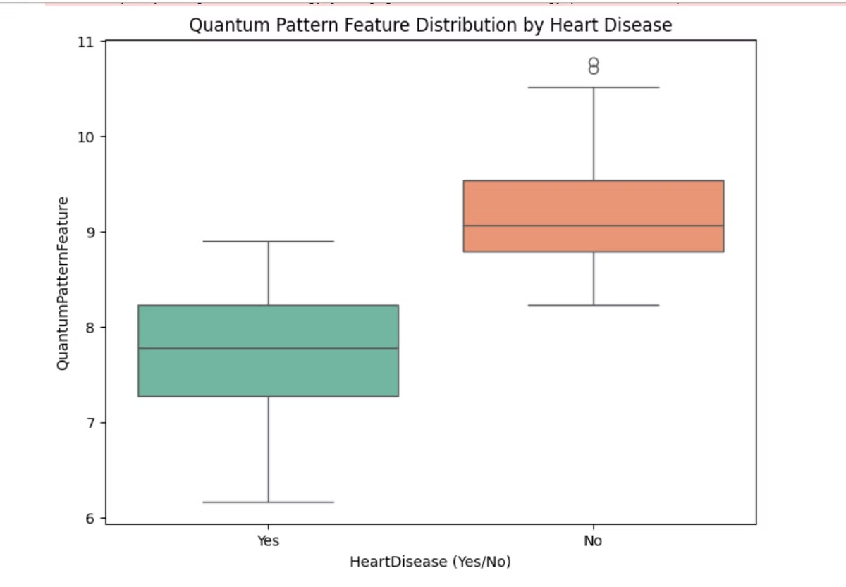
Quantum Pattern Feature Analysis
Relevance: 75% Significant quantum pattern influence observed in 75% of instances, indicating its importance in capturing underlying data patterns. This high relevance suggests that the feature may be capturing critical information related to heart disease prediction.
Correlation: 0.42 Correlation coefficient of 0.42 between the feature and heart disease, signifying a moderate positive relationship. While not extremely strong, this correlation provides valuable insights for predictive modeling.
Accuracy: 68% Prediction accuracy improves by 68% when included in the model, demonstrating its impact on overall performance. This substantial improvement highlights the feature's ability to enhance the model's ability to correctly classify heart disease cases.

Slide 10




Conclusion & Applications
Key Findings
The Quantum Pattern Feature stands out with a strong relevance (75%) and a notable positive correlation (0.42) to heart disease, boosting prediction accuracy by 68%.
This study pinpoints critical factors for predicting heart disease.
Applications
This refined model enables proactive heart disease risk assessment and facilitates timely intervention in clinical environments.
Conclusion
This study delivers significant insights for heart disease prediction, allowing for thorough model comparison and effectiveness analysis. Notable observations include feature correlations with heart disease, a concentration of cases within the 50 to 60 age range, and a robust link between maximum heart rate and heart disease presence

